Slide 1
Music: Creativity and Practicality

Slide 2
Entrepreneurs versus Managers
Entrepreneurs: may operate as a sole trader or as the founder of the firm with responsible for its day-to-day running.
-Advantages: Quite a lot of autonomy over decision making
-Disadvantages: As their business grows, they may no longer be able to be so directly involved in all areas of operations. One solution is to seek additional resources externally (for example new staff, out-sourcing)
Managers: usually an employee within a larger organisation
-Advantages: help to adapt structure to strategy and to develop adequate control and coordination procedures; make work as a part of a wider team with complementary skills
-Disadvantages: less autonomy in decision making; change can be slower in a larger organisation

Slide 3
How might an entrepreneur establish their business?

Slide 4
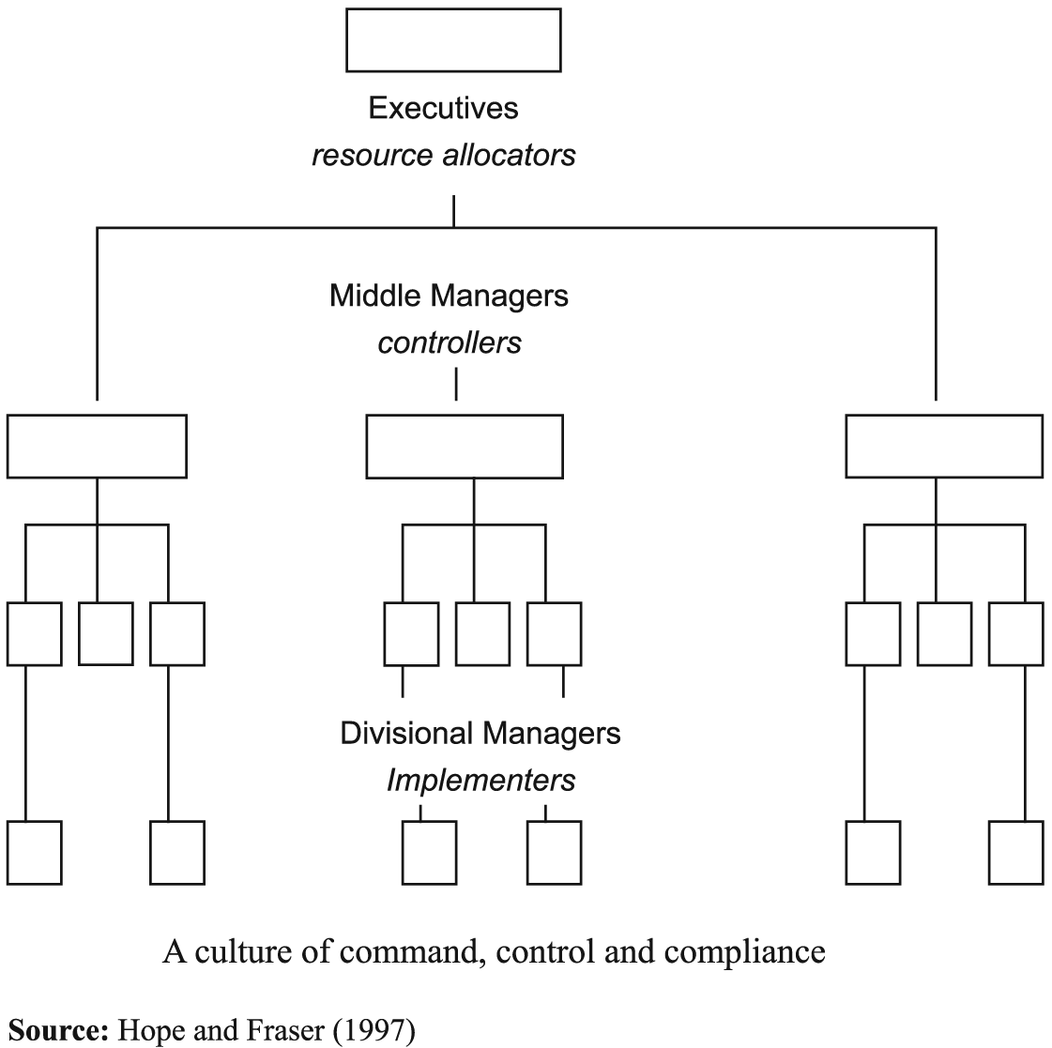
How might a manager work within a business?
Notes:
U

Slide 5
Views of entrepreneurship
What does an entrepreneur do?
-’high level’ activities like innovation and risk taking
-’low level’ activities like identifying opportunities for arbitrage
Cantillon (1759) entrepreneurs specialise in taking risks
Knight (1921) developed this and saw entrepreneur as making a profit by dealing with uncertainty (unpredictable events rather than risk (predictable events)
Schumpeter (1934) entrepreneur innovates, especially by creating new industries (ie railways)
Marshall (1919) recognised ‘low level’ entrepreneurship (ie industrial production in workshops)
1980s entrepreneurs exercise judgement in their decision making
All agree that entrepreneurs are important
‘An entrepreneur is shown to be a person who takes responsibility for difficult decisions and who reallocates resources to more efficient uses’

Slide 6
Chandler’s view of big business
Focuses on USA in period c. 1890-c.1940-the ‘Second Industrial Revolution’
Opportunities are the opening up of new markets and development of new forms of technology
These are exploited by 3 pronged investment in manufacturing, marketing and management
Managers play a key role
The “visible hand” of management became the main system of coordination of the economic activity
Businesses grew further through
-vertical integration
-horizontal integration
Notes:
The development of this model of management for a larger business was identified by Chandler
He argued that during the period c. 1890-1940 new markets developed and new forms of technology were created t(for example cars, chemicals and oil)
These are exploited by 3 pronged investment in manufacturing, marketing and management
3 pronged investment helps to achieve economies of scale and scope because ‘a more integrated production process allowed producers the opportunity to impose more standardised goods on consumers and to assess market trends more easily’
He was very much focused on looking at how the creative idea could be quickly scaled up
Managers play a key role in ‘adapting structure to strategy and in developing adequate control and coordination procedures’
The “visible hand” of management became the main system of coordination of the economic activity
This is in contrast with the “invisible hand” of the market theorised by Adam Smith. The market (i.se. competition among forms) determined the selling price of good which, in turns, determined the structure of costs and the survival of firms.
Big business controlled the market and imposed goods and prices to consumers
Businesses grew larger through
Vertical integration is when an upstream activity eg mining and a downstream activity eg processing are owned by the same firm: A car manufacturer that produces their own engine is an example of vertical integration as is in the meat industry:slaughtering, packing , distribution and sales are integrated
Horizontal intergration is about exploiting the same knowledge in different locations in different plants
When all of the plants in the different locations are owned by the same firm they are said to be horizontally integrated

Slide 7
Can the two approaches be reconciled?
Notes:
The two seem very different but are there areas in which they can be reconciled
As we have seen, once the entrepreneur has founded the business, they need to think about how to grow and scale it
This is the stage at which they may need to start delegating activities
However if they go too far, they could lose the initial creativity in the business
Achieving a balance of the best elements of entrepreneurial and managerial working can help you to create new value for your product or service

Slide 8
Structure of the music business
Creativity Composers Performers Teachers Performance venues Musical instrument makers/sellers Musical suppliers 9music paper, strings etc | Distribution Music shops Promotion-WOM, handbills, adverts etc Ticket sellers
Reproduction Music printers/publishers Recording studios | Consumption Audience at live events Purchasers of printer music, musical instruments, tuition etc Purchasers of records, CDs and downloads
Source: adapted from Catherine Harbor

Slide 9
Turning a creative activity into a business

Slide 10
London’s music scene 1660–1750
Risks and opportunities for entrepreneurial musicians:
-Risks: Disruption in employment from patrons (especially the court) due to the English Civil War
-Opportunities: Urbanisation; Improvements in technology; Increasing strength of intellectual property rights(Harbor)
Solutions: musicians innovate the ways they distribute, and reproduce music and change their consumer focus
-Consumers: residents of towns (rather than aristocrats and royalty) via concerts and sheet music
-Distribution: leaflets and adverts to publicise public concerts
-Reproduction: musicians create their own sheet music (sold alongside the concert tickets in music shops)
Takeaway: Musicians adapt to loss of a managerial model in which they were often employees of the court. They adapt to self-employment but include managerial elements by changing their strategic focus to urban consumers and operating across more than one consumption channel (concerts and print music)
Notes:
Risks and opportunities for entrepreneurial musicians:
-Risks: Disruption in employment from patrons (especially the court) due to the English Civil War. Disruption to music business caused by English Civil War (1642-51) – limited court employment for musicians and Cromwell places limitations on public performances
-Opportunities:
Urbanisation: growth of London provides opportunities for recreational music and provides a new and expanded audience for musicians
Improvements in technology: Improvements in printing make sheet music easier to read and perform
Increasing strength of intellectual property rights: The sale of sheet music is encouraged by new rules which provide some intellectual property protection for the author, guareenting a period of time when they can exclusively receive the profits from sales and royalties from public performances
Solutions: musicians innovate the ways they distribute, and reproduce music and change their consumer focus
-Consumers: residents of towns (rather than aristocrats and royalty) via concerts and sheet music . Movement away from a retainer funded by aristocratic or royal patronage as the source of income for a musician. The new source of income is ticket sales from private concerts and tie-ins with publishers
-Distribution: leaflets and adverts to publicise public concerts . Musicians start to use leaflets and, increasingly newspaper adverts, to publicise concerts, from which they generate a revenue by selling tickets
-Reproduction: musicians create their own sheet music (sold alongside the concert tickets in music shops): Some musicians compose music which they sell. Sheet music shops are also where most concert tickets are sold
Takeaway: Musicians adapt to loss of a managerial model in which they were often employees of the court. They adapt to self-employment but include managerial elements by changing their strategic focus to urban consumers and operating across more than one consumption channel (concerts and print music)
Handel’s water music for George I
John Gay’s satarical the beggar’s opera from 1.29

Slide 11
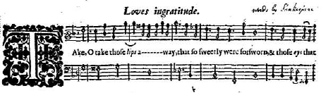
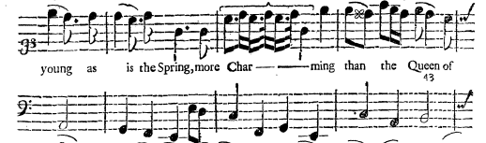
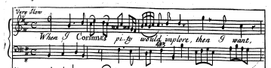
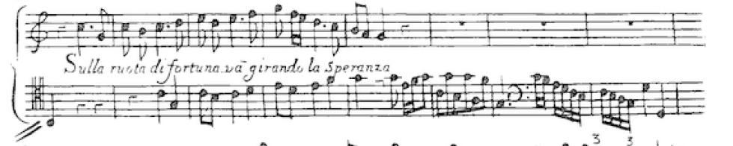
Improvements in Printing
Music printing:
Typeset music – late 15th-century onwards
John Heptinstall’s “new ty’d note” (1687 onwards)
Etching/engraving on copper (Thomas Cross c. 1683 onwards)
Engraving on pewter with punches (John Walsh c. 1700 onwards)
Source: Catherine Habor
a
b
c
d

Slide 12
Music publishing in America in the 19th century
Creation and dissemination of sheet music
The railway network allows sheet music to be distributed much more widely than previously, and it begins to scaled-up as an industry
Publishers operated a model whereby they had the ‘staple’ items (often hymn books, beginners exercises, ‘traditional’ songs) and then innovative items (for example ones that reflected current events or was marketed very much as a ‘romantic song’
Takeaway: Creative and ‘standard’ items are combined. This helps to limit risk

Slide 13
Strawberry Studios , Stockport
https://www.youtube.com/watch?v=tN5v_9A8DTw
Established in 1967 in Stockport for northern bands who otherwise had to go to London to record (including The Beatles)
Addressing reproduction
Business model:
-staple items during day
-experimental items in evening
Outcome: both managerial (two spin-out studios and a technology spin-out) and entrepreneurial (the band 10cc) 10cc Not in Love
Profits re-invested in business: success of band raises profile of studio (1972 single Donna number 2 in charts) and provides financial capital for the 2 spin-out studios
Takeaway: Good balance of aspects of both models but was unable to retain its investment in new technology from the 1980s onwards

Slide 14
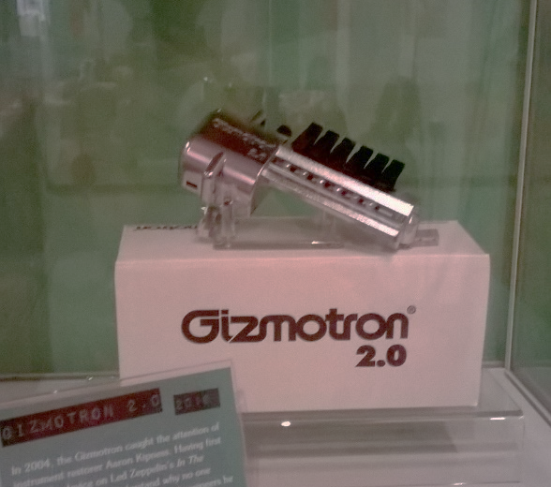
Technology spin-out: Gizmotron

Slide 15
The rise of the managerial model
Notes:
Improvements in technology and changes in society provided opportunities to further extend the distribution of music- records and radio meant that individual artists could be hear by consumers in their own homes and meant that music could be distributed beyond the geographical range of concerts
As standards of living improved, entrepreneurs saw the opportunity to extend the consumer base to teenagers

Slide 16
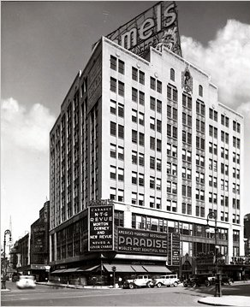

Rock and Roll and The Brill Building
Rock and Roll : late 1940s and early 1950s , music easily disseminated via TV and radio
1954 by Bill Haley and the Comets
Core audience were teenagers
Brill Building applied principles of vertical integration to music
Segmentation of creative process: writers and composers don’t record while artists record but don’t write or compose. Little opportunity for entrepreneurship
This song was written by a pair of writers from the Brill Building
Takeaway: this model was commercially successful but many writers from the Brill building felt stifled creatively and left as a result
Notes:
Rock

Slide 17
The Underground Music Scene and Stock, Aitken and Waterman
Turned electronic dance music into ‘squeaky clean’ records
SAM model
1.write the songs
2. bring in drums and synthesisers
3. put down a vocal
Songs and singers were pretty interchangeable
Some SAM artists were more creative However SAM were increasingly criticised for lack of creativity Produced 13 UK number one hits and around 80 different acts during 1980s and 1990s
Takeaway: Inspired by creativity in other sectors, but over time became criticised for being “ Schlock, Aimless and Waterdown“ and the hits started to dry up in 1990s. Continous innovation is necessary to keep ahead creatively

Slide 18

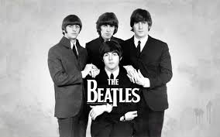

The Independent Labels
Pioneered by the Beatles (Apple) and Rolling Stones (Rolling Stones)
A reaction against the increased dominance managerial model, and a return towards an entrepreneurial model
Sometimes an independent label will maintain a relationship with an established label, with the established one providing the distribution channel
Takeaway: Creativity can be encouraged by having larger labels and independent labels working side by side. Independent labels may be more willing to take creative risks.
Notes:
In order to develop more creative control some artists wanted to break-away from large labels or controlling producers and found their own labels
the Beatles (Apple), the Rolling Stones (Rolling Stones) are seen as pioneers in this respect
Some acts develop an independent label in order to ensure longevity or rebrand themselves, or because they want more flexibility later on in their careers
2010 Backstreet Boys left their long-term label Jive and founded their own label in order to avoid being tied into a deal depending on a number of albums (i.e. one or three)
The danger of successful acts leaving to found their own labels is credited with pushing larger companies, in many cases, into allowing artists more leeway in their choice of repertoire
Sometimes an independent label will maintain a relationship with an established label, with the established one providing the distribution channel
Ed Sheeran recently founded his own label, which will be ‘housed’ under Warner, because he was ignored by industry executives when he tried to promote the group Passenger, who went on to have a number one hit . However in the 1980s many independent labels were eventually purchased by large labels and totally subsumed into them

Slide 19
Emerging risks and opportunities

Slide 20

Abbey Road
https://insideabbeyroad.withgoogle.com/en
Opportunities: Famous for its links with the Beatles and still a popular venue for recording film scores
Risks: Musicians can increasingly record directly on their computers without needing to go to a studio
New business model based on promoting entrepreneurship, serving independent musicians and providing studio services remotely
Initiatives include
-online, cloud-based mastering
-software and hardware available to musicians to recreate the studio’s instruments and acoustics.
- Abbey Road Red incubator for start-ups

Slide 21
Rise of digital channels
The music industry is also facing a broader problem due to the rise of digital channels.
Consumers want more control over what they purchase (ie specific tracks from albums rather than the whole album) and revenues are falling due to piracy
Solutions:
-New formats for selling music
-Involvement of artists in a greater range of revenue streams

Slide 22
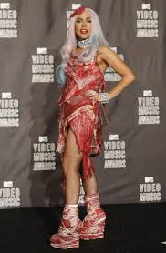
Rise of digital channels
Launched under ‘« 360 deal » in which music companies share a proportion of revenues from every aspect of the artist’s business’ (clothes lines etc as well as music)
Lady Gaga has an unusually large amount of creative control relative to many artists
Takeaway: Both artist and label seem to be happy with this balance, as allows creative input from artist while tacking the label’s financial concerns

Slide 23
The Kaiser Chiefs
UK hit singles include 2004 and 2005 number 9 hit ‘I Predict a Riot’ and 2007 UK number 1 hit ‘Ruby’
2010-11 Kaiser Chiefs decided to use a new format for their album ‘The Future is Medieval’
Intended more to deal with an image problem than the general lack of popularity of albums as a format
Model:
-fans customised the album by picking 10 tracks out of 20
-designed their own artwork
Incentive
-cost was £7.50
-fans had permission to then sell the version of the album they made#
Not intended to replace the physical version of the album, but many fans were confused
Takeaway: Launch a new format carefully and be clear on what you want it to achieve. In this case fans seem not to have wanted the extra creative control

Slide 24
The Entrepreneurial Management Model
Entrepreneurial working
Opportunity focus:
New markets (ie urban consumers, teenagers)
Rapid innovation:
Changes in technology and mprovements in transport provide threats and opportunities
Creating customer appeal:
Adaption of successful formats (ie underground music) and customisation of products
Challenge the orthodox
Independent labels
Managerial working
Strategic focus:
Ensuing that the costs of the production of the product are met
Managing resources:
Coordinating the process of making the record (artists, composers, technicians), marketing it (managers, publicists), distributing it (studios).
Managing relationships: between artists and label and between artists and consumers
Systematic value management:
360 degree contracts and hit factories
Creating new value
Responsiveness to changes in the external environment
Continued payment for music and music related services (to support the creativity)
Continuation of the framework of reproduction, distribution and consumption during both threats and opportunities in external environment

Slide 25
Further reading
Catherine Harbor (2017) ‘At the desire of several persons of quality and lovers of Musick’: pervasive and persuasive advertising for public commercial concerts in London 1672–1749, Journal of Marketing Management, 33:13-14, 1170-1203, DOI:10.1080/0267257X.2017.1380687

